Slide 1

Financial Awareness & Retirement Planning

Slide 2

Retirement Planning
The Need
TRS - The Base Review
Learn More
http://www.trs.state.tx.us

Slide 3
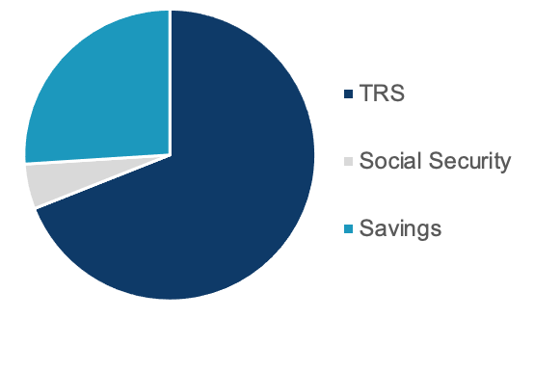
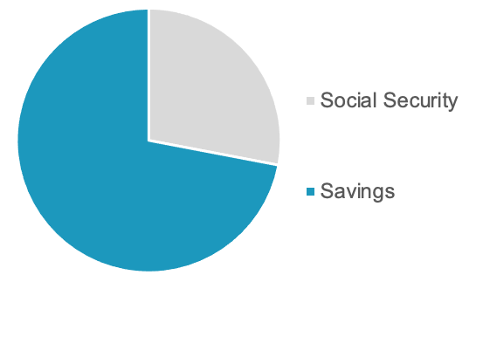
TRS vs. Corporate Retirement
Income in retirement is very different for educators than it is for their spouses and neighbors outside of education.
Educators
Neighbors

Slide 4
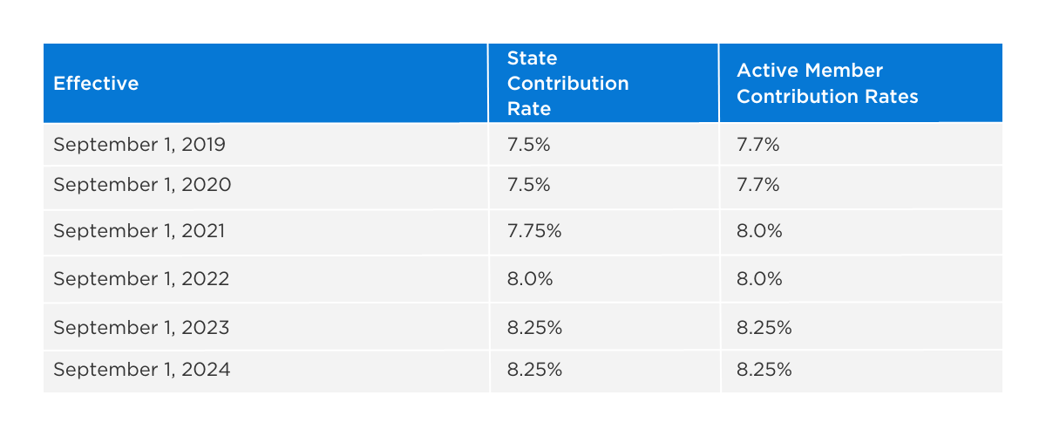
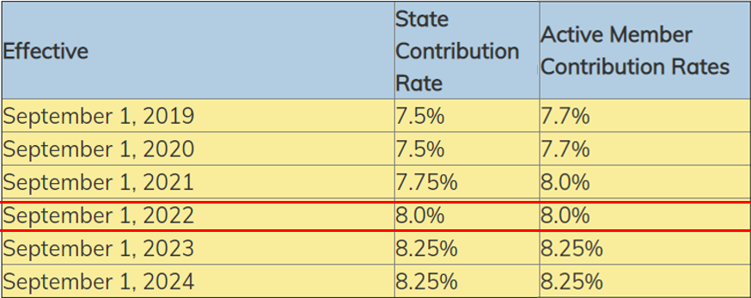
Texas Teacher Retirement System
TRS administers a pension trust fund that has been serving the needs of Texas public education employees for over 80 years.
You become a TRS member on the first day of eligible employment
TRS is a Defined Benefit Plan
Additionally, you also contribute 0.65% of your salary and the District contributes 0.75% of your salary towards TRS–Care, the retiree group health benefits program.

Slide 5

TRS Retirement
Eligibility
TRS retirement values are determined by many factors:
  When you became eligible for TRS Service Credit
  Your years of service
  Your age
  Your income for those years
For your individual status, login to your MyTRS account or contact TRS directly.

Slide 6
Rule of 80!
The Rule of 80 is the qualifier, not the percentage
To be eligible for Normal-Age service retirement, you must meet one of the conditions within your tier
The same is true for Early-Age Retirement Eligibility
Age
Yrs. Of Service
80

Slide 7

Grandfathered or Non-Grandfathered
Individuals who were members and met one of the following conditions by August 31, 2005 are considered Grandfathered:
At least age 50
At least 25 years of service; or
Met the rule of 70
Grandfathered : 3 years average
Non-Grandfathered : 5 years average

Slide 8
Texas Teacher Retirement System
Standard Annuity Retirement Formula
Years of Service
X
State Factor: 2.3%
X
Average of five highest years income*
*some employees must use 3-year average (dependent on your tier)
Maximum Annual Benefit

Slide 9
Retirement Gap
30
Total Years of Service Credit
$50,000
Average salary
X
X
2.3%
69%
State Factor
Total %
69%
$34,500
Total %
Maximum Benefit
Available Retirement Income: $34,500
Monthly Pension = $2,875
Pre Retirement Monthly Salary = $4,167

Slide 10

TRS Retirement Sessions
Presented by TRS
Click the link below to see available dates & times for the following:
  Retirement Benefit Presentations (virtual & in person)
  Field Office Visits (in person)
  Retirement Forms Session (virtual)
Click Here

Slide 11
Helpful Links
MyTRS Login
TRS Financial Awareness
Video Series
  Register or login to MyTRS
  Plan for retirement
  Communicate with TRS
  View annual statements and other documents
  Change income tax withholdings
  Learn about your TRS defined benefit plan
  Discover what you need to save more
  Find out how to get what you need by saving smart
Click Here
Click Here

Slide 12
I choose to have the
choice for my future
Bridging The Retirement Gap

Slide 13

Bridging the Retirement Gap
Supplement TRS Retirement
A savings/investment plan to supplement TRS retirement:
  A Cookie Jar/Piggy Bank
  Bank/Credit Union Savings Account
  CD's, IRA, Roth IRA
  IRS Tax Favored Retirement Plans
    Payroll Deduction:
      Most effective
      Painless

Slide 14
How it works
The Math

Slide 15

Retirement Savings Example
$200 Monthly Savings Plan
MARIA’S SAVINGS PLAN
Starting Age: 25 years old
Ending Age: 65 years old
Total Years: 40 years
Monthly Contribution
x
12 months
Annual Contribution
$200
Monthly Contribution
Annual Contribution
x
Years of Service
Total Contribution
$2,400
Annual Contribution
$200 x 12 months = $2,400
$96,000
Total Contribution
$2,400/year x 40 years = $96,000

Slide 16

Retirement Savings Example
$200 Monthly Savings Plan
ANDY’S SAVINGS PLAN
Starting Age: 35 years old
Ending Age: 65 years old
Total Years: 30 years
Monthly Contribution
x
12 months
=
Annual Contribution
$200
Monthly Contribution
Annual Contribution
x
Years of Service
=
Total Contribution
$2,400
Annual Contribution
$200 x 12 months = $2,400
$72,000
Total Contribution
$2,400/year x 30 years = $72,000

Slide 17
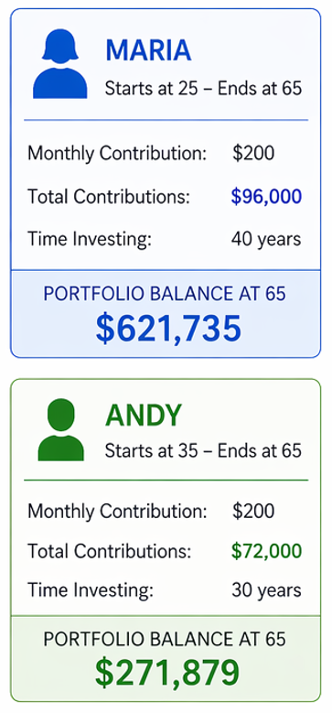
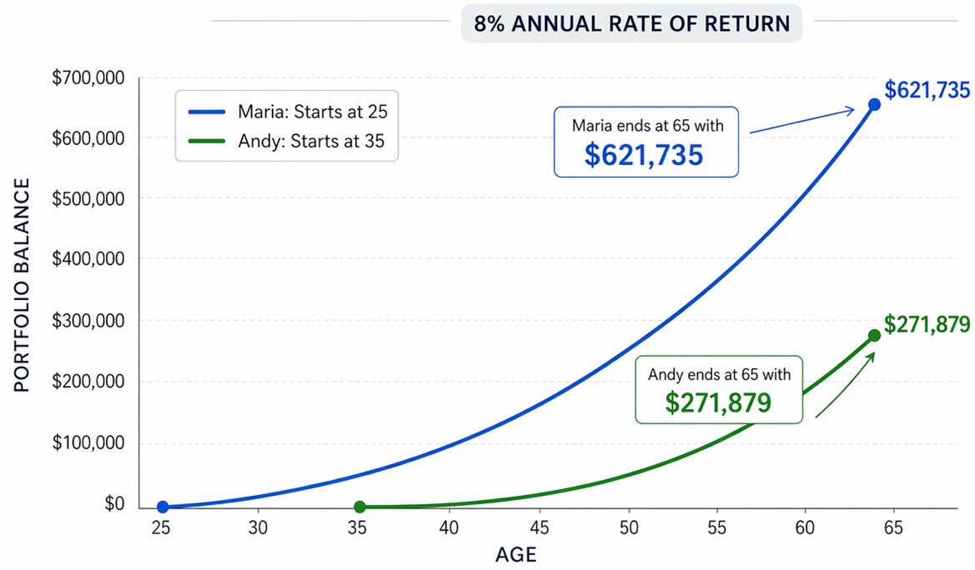
The High Cost of Waiting
Start Saving Today!

Slide 18

Save Some Beans!
Size down & save big
Go for a medium daily coffee instead of a large and the money you save could be better served towards your retirement fund.
For example, downsize to invest $40 a month in your retirement plan and you could have an extra $41,000 by the time you retire!

Slide 19


Savings Advantages
403(b) & 457
  Federal income tax deferred until savings distributed as income.
  Allows savings to grow tax deferred.
  Diversification during volatile times.
  Having a 403(b) and a 457 account allows the best of both worlds – different pots of money used different ways.

Slide 20
Plan Comparison
403(b) vs 457
403(B) Plan
457 Plan
Individual Retirement Plan
Employer Sponsored Plan
  10% IRS penalty if withdrawn prior to age 59 1/2
  Investment choices vary depending on the company you elect.
  Contact your Financial Advisor or find companies listed on www.ffga.com
  No IRS penalty for withdrawals at separation from service from employer, regardless of age.
  Multiple investment options covering all asset classes
  Fixed and variable sub-accounts, and mutual funds
  Contact your FFGA Account Executive

Slide 21
What questions should I ask?
For Retirement Planning
  What are the fees associated with the account?
    Annual administration charge? Market fees? Expense Ratios?
  Is there a surrender schedule?
  When I withdraw funds, am I charged a fee or penalty?
  If I take out a loan, what are the charges/fees?
  What are my distribution options when I retire?

Slide 22
FAQ
Frequently Asked Questions

Slide 23
How much can I save?
You determine the amount!
2026 IRS Limit:
  Maximum: $24,500 per tax year
  Age 50 or older can save up to an additional $8,000 year
Super Catch Up:
  Age 60 - 63
  May be eligible for an additional $11,250 contribution

Slide 24

Catch up Opportunities
Retirement Contributions
If you are over 50 years old and maxing out your 401(k) contributions, fully contributing “Catch Up” amounts between now and retirement may allow you to save an additional $159,400.
*Assumes annual catch up contribution of $6,000, 7% rate of return and 15 years of retirement.

Slide 25

When can I take the money out?
Taking money out is called a “Distribution”
IRS regulations govern the rules for Distributions for both 403(b) and 457 plans.
Generally, Distributions are allowed for:
  Retirement/Separation from Service
  Financial Hardship/Unforeseen Emergency
  Permanent Disability
  Death

Slide 26
Is the money/distribution taxable?
Yes, Ordinary Income Tax for both 403(b) and 457 plans.
  For 403(b) plans there is a penalty tax for distributions prior to age 59 ½, in addition to ordinary income tax.
  For 457 plans there is no age restriction for distributions once you are separated from service.

Slide 27
If I leave, can I take my plan with me?
The money in your plan is vested
The money in your plan belongs to you, wherever you are employed. You may transfer/rollover OR use funds to purchase service credit from TRS.

Slide 28
Can I continue to contribute to my plan?
In some cases, yes.
The ability to continue to contribute to your plan is governed by State and Federal Regulations and your new employer’s plan documents governing their plans.
Ask your representative for details.

Slide 29

WHAT'S NEXT?
Pay yourself first
Get started today!
Request additional info &/or schedule an appointment

Slide 30

THANK YOU
Get in touch with us for inquiries:

