Slide 1






x
Be fully prepared and confident
with Legal Insurance
Jefferson Parish School Board
Administered By:
Notes:
Hi My name is Carrie Lacey and I’m excited to shed some light on the legal plan that is offered to you! Because I have so little time with you today, any questions that you may have for me regarding the plan, hold those until the end – I’ll probably answer many of your questions within the slides.

Slide 2

A legal insurance plan can ease the biggest stresses – finding and paying for legal expertise when you need it most.
LegalEASE believes in happy and healthy employees, at work and at home.
02
Notes:
First of all, why do we offer a legal plan?
It’s really to help provide support for your time in need as far as coverage goes as well as financial assistance when paying for an attorney’s fees.
It can be a stressful time when trying to find the right attorney when a legal matter comes up, we are here to help ease the stress and provide assistance every step of the way
*Anna ideas for poweroint

Slide 3




The Numbers
More than 70% of those needing an attorney in the next 12 months don’t know how to tell a good lawyer from a bad one.²
Over 70% of people will have the need for a lawyer in the next 12 months.¹
Affected
Total employees
¹ Source: American Bar Association
² Source:American Bar Association
03

Slide 4


The Numbers
”
”
An Attorney charges on average
$400 per hour.
On average, it costs
$1,500 for estate planning documents
What non-members can expect to pay:
+
=
Retainer Fee
$5,000 to $25,000
Litigation Fees
$10,000 to $50,000
$15,000 to $75,000 total cost to Employee
04

Slide 5





A Legal Insurance Plan Can Assist During Life Events
Employees
In their 30s
Will and Estate Planning
Buying/Selling/Refinancing
Your Primary Residence
Adoptions
Employees
In their 20s
Tenant Dispute
Traffic Matters
Employees
That are Expecting
Will and Estate Planning
Purchase/Sale of Primary Residence
Name Change
Employees
Getting Married
Name Change
Purchase of Primary Residence
Guardianship/Conservatorship
Governmental Agency Adoptions
Employees
In their 40s
Living Trust Document
Foreclosure
Guardian/Conservatorship
Employees
With Teenagers
Traffic Matters
Misdemeanor Defense
Consumer Dispute
Employees
In their 60s
Will and Estate Planning
Living Trust Document
Sale of Primary Residence
Health Care Power of Attorney
General Power of Attorney
Employees
In their 50s
General Power of Attorney
Living Will
Guardianship/Conservatorship
Living Trust Document
05
Notes:
Many people have this idea they have to be a certain age or live a certain lifestyle to need an attorney.But the reality is that everyone has a use for an attorney, especially as we hit milestones in our lives.
Everything from graduation to renting a first apartment, or getting married and starting families all the way to retirement. Attorneys aren’t just there to represent you (either as a defendant or plaintiff) when when something bad happens, attorneys can also help set up protections for you and your family, and help you preserve and pass along wealth through generations.

Slide 6
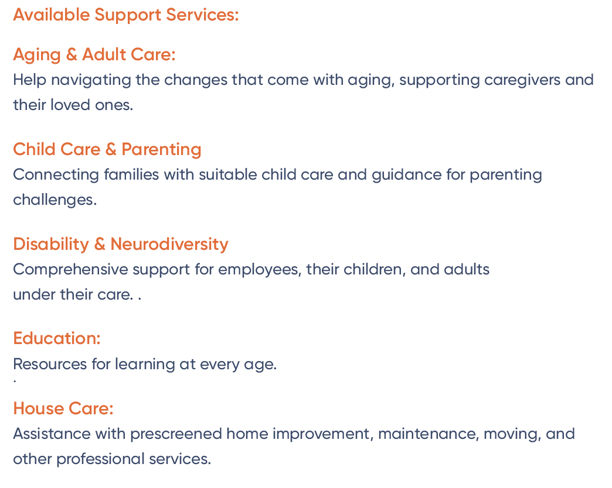
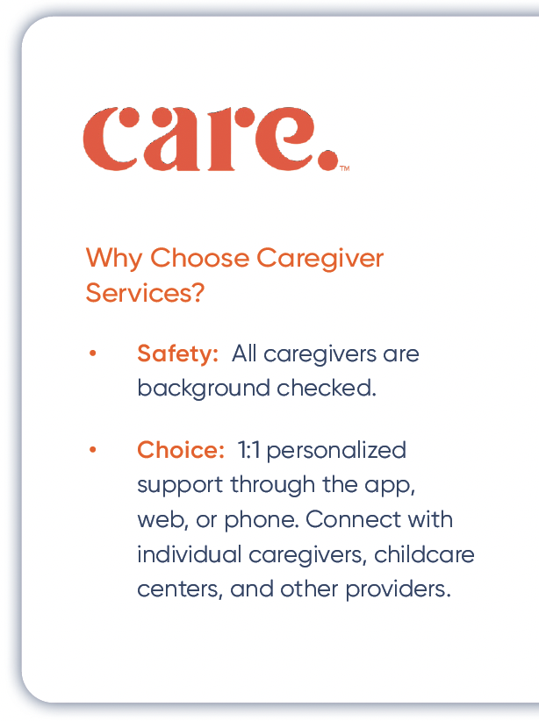

Caregiver Services through LegalEASE
Employees
In their 20s
Landlord/Tenant Dispute
Traffic Matters
DUI/DWI Defense
Finding reliable, safe, affordable, and trustworthy caregiving can be a challenge. To help ease this stress, LegalEASE provides members with access to the world’s largest network of in-home and facility-based care.
Members can find certified care for children, seniors, pets, tutoring, housekeeping, and more. Whether you need a trusted sitter, assistance finding full-time care for aging family members, or someone to watch the family pet, Caregiver Services is here for you.
Call 888-416-4313 to connect with expert Care Specialists and explore the Caregiver Services included in your LegalEASE plan.
Let Caregiver Services help you navigate life’s changes and challenges.
Limitations and exclusions apply. This benefit summary is intended only to highlight benefits and should not be relied upon to fully determine coverage. More complete descriptions of benefits and the
terms under which they are provided are received upon enrolling in the plan. Group legal plans are administered by Legal Access Plans, L.L.C. or LegalEASE Home Office: 5151 San Felipe, Suite 2300,
Houston, TX. ©2024 LegalEASE All rights reserved.
06

Slide 7
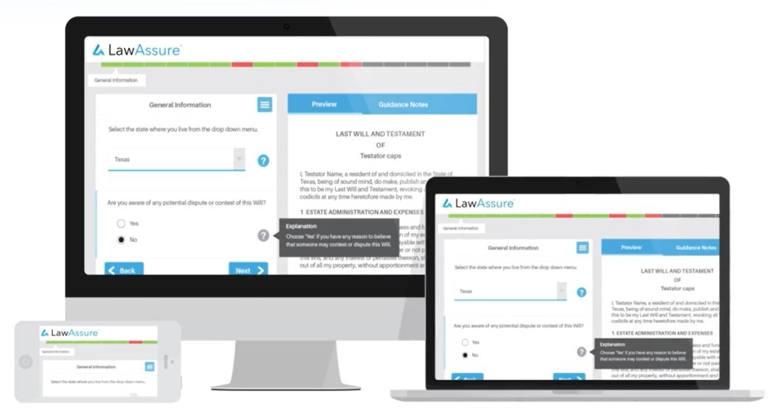
LawAssure Online Document Center
Manage Your Legal Affairs With Ease
Your LegalEASE Plan now includes the online LawAssure legal document center. LawAssure is a DIY option that gives you the ease of creating legal documents without a lawyer. Available on most devices and accessible 24/7, LawAssure lets you create estate planning, consumer, and civil legal documents.
Prepare Legal Documents For:
Estate Planning, including Wills, Trusts, and POAs
Healthcare Directives
Landlord and Tenant Documents
Consumer Documents, including purchase and sales agreements
Promissory Notes, Complaint Letters, and much more
https://legalcorner.legaleaseplan.com
07

Slide 8
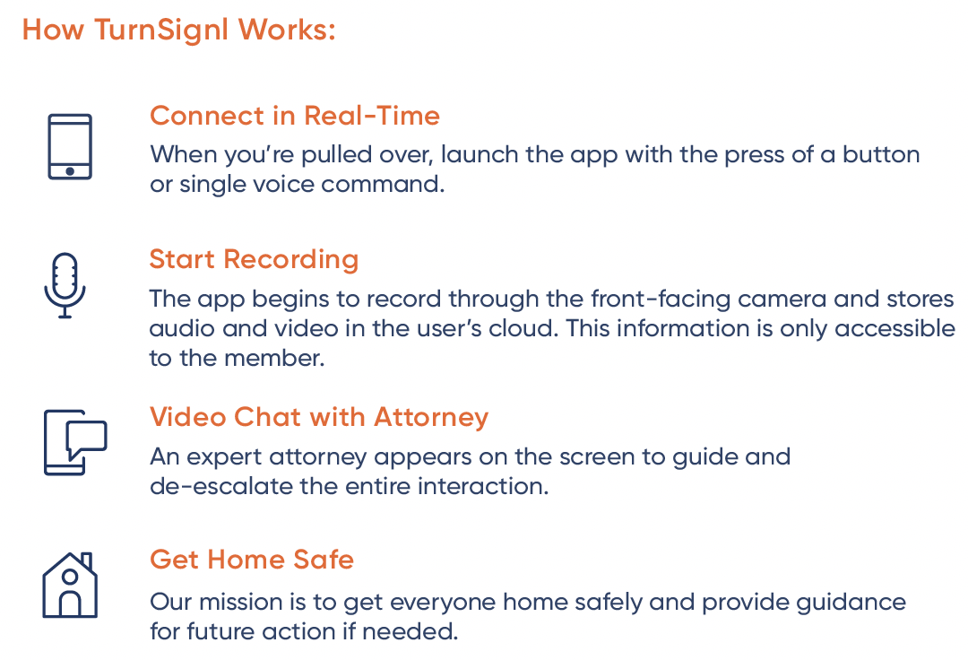
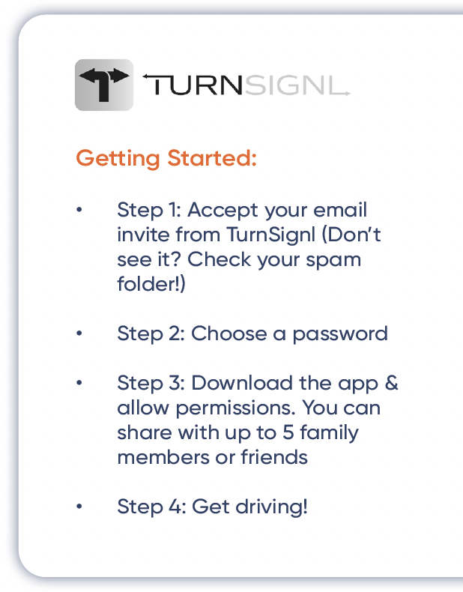
Members Drive Stress-Free With TurnSignl
What Is TurnSignl?
TurnSignl is a groundbreaking mobile app that allows drivers and their families to chat face-to-face (think “FaceTime”) with an attorney when they’re pulled over or in an auto accident.
Attorneys on TurnSignl are experts in personal injury, traffic issues and criminal law, and trained to help ease anxiety and reduce tension during these interactions.
TurnSignl’s mission is to de-escalate roadside interactions, protect a members’/families’ civil rights and ensure both drivers and law enforcement return home safely.
You deserve peace of mind on every drive.
Download TurnSignl today and you’ll always have an attorney in the passenger seat.
Learn more: turnsignl.com/legal-ease
Please note that neither TurnSignl, LegalEASE, nor Employer endorses or recommends any lawyer or law firm that advertises on TurnSignl's platform, and make no representation and have not made any judgment as to the qualifications, expertise, or credentials of any lawyer or law firm participating on TurnSignl's platform. In offering these legal plan benefits to its employees and their covered family members as defined under the terms of the legal plan ("Users"), Employer does so without any guarantees or warranties, either express or implied. Neither LegalEASE nor Employer shall be liable for any personal injury, damages or losses arising from any User's use of the TurnSignl app or associated legal guidance or services. Users release and discharge, to the fullest extent permitted by law, LegalEASE and Employer and their respective related entities, and the officers, employees, and agents of each, from any and all claims, damages, loss, cost, or expense that may result directly or indirectly from use of the TurnSignl app or associated legal guidance or services.
08

Slide 9

The Process of Finding an Attorney
NO LEGAL PLAN
LEGALEASE
LEGAL PLAN
Internet Search
Recommendation of an attorney
Finding an attorney to return messages
Finding the right attorney for your legal issue
It takes an average of 3.8 days¹ to find an attorney
Live/Phone concierge matching – case opened
Introduction to the Attorney
LegalEASE Member Services follows up with member for the life of their case
Matched to an attorney in 2 days or less
¹ Source: LegalEASE Employee Health; Legal & Financial Stress Impact Study, 2016, Part II
09

Slide 10
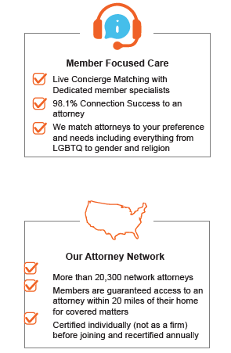


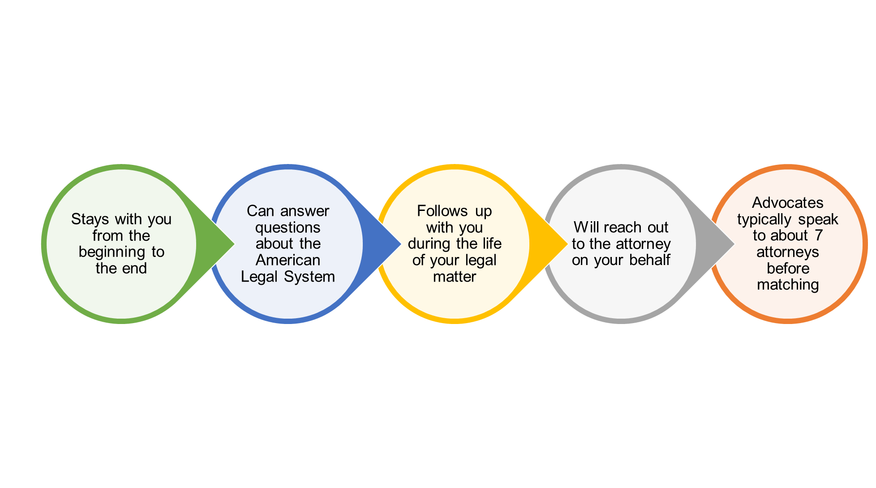
What You Get With A Legal Insurance Plan
What you get with a Legal Benefits Plan
Benefits of a LegalEASE Plan
• Coverage for in and out-of-network
• Concierge assistance navigating common legal issues
Member Focused Care
Our Attorney Network
Live Concierge Matching with Dedicated member specialists
98.1% Connection Success to an attorney
We match attorneys to your preference and needs including everything from LGBTQ to gender and religion
More than 22,000 network attorneys
Members are guaranteed access to an attorney within 23 miles of their home for covered matters
Certified before joining and are recertified annually
Advocacy Help During the Entire Legal Matter
10

Slide 11

What You Get With A Legal Insurance Plan
Benefits of a LegalEASE Plan
• An attorney with expertise specific to your legal matter
• Access to a national network of attorneys with exceptional experience that are matched to meet your needs
Our Vetting Process
Board-Certified Examination
State-Licensed – Locality of Member
Examine their Law Practice History
13 Background Question Certification
Community/Law Practice Record
Review of E&O/Discipline Record
Penalty of Perjury Submissions
Insurance Requirement
10 years of Attorney Experience
Professional Conduct Code
With over 22,000 attorneys in our network, we are the largest U.S. provider
Attorneys are interviewed and pre-screened before matching them to a member.
11

Slide 12
Plan Pricing
”
”
An Attorney charges on average
$400 per hour.
On average, it costs
$1,500 for estate planning documents
Instead of all those high prices, LegalEASE offers….
12

Slide 13




Plan Pricing
Instead of all those high prices, LegalEASE offers….
Plan Details:
Employee
Spouse
Dependent Children
Up to age 26
Parents
$18.84 monthly, via payroll deduction
Who’s
Covered:
13

Slide 14

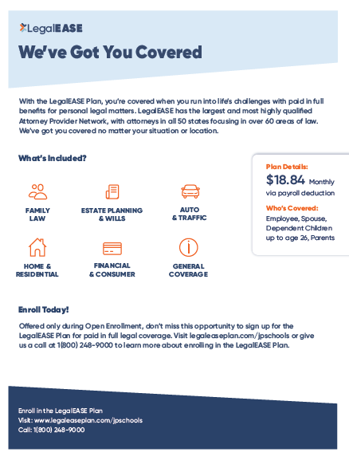
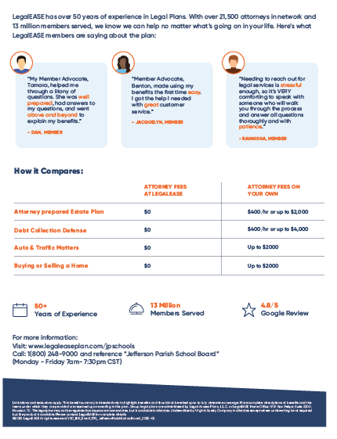
Reference Material
Employee Flyer
Flyer features offered benefits and plan price information.
14

Slide 15



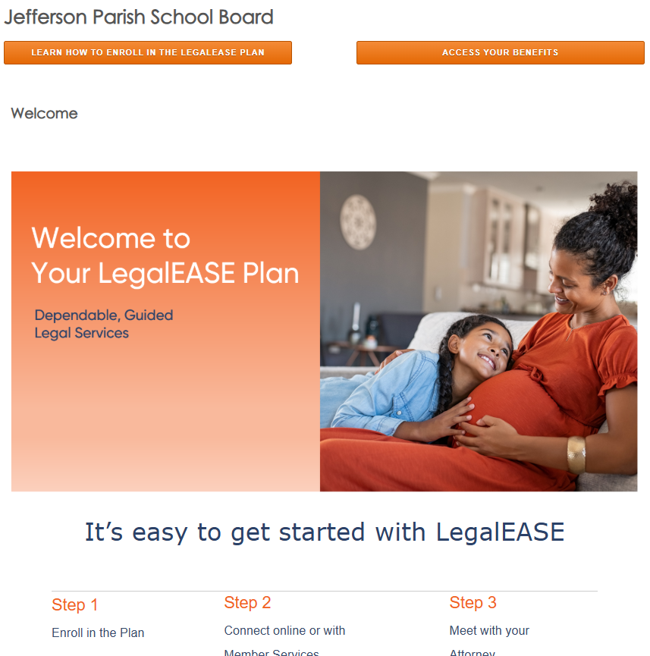
Your Customized Microsite
https://www.legaleaseplan.com/jpschools
15

Slide 16



We’re Here When You Need Us
For more information, visit: https://www.legaleaseplan.com/jpschools
To learn more, call: 1(800) 248-9000
16

Slide 17

Limitations and exclusions apply. This benefit summary is intended only to highlight benefits and should not be relied upon to fully determine coverage. More complete descriptions of benefits and the terms under which they are provided are received upon enrolling in the plan. Group legal plans are administered by Legal Access Plans, L.L.C. or LegalEASE Home Office: 5151 San Felipe, Suite 2300, Houston, TX. This legal plan may not be regulated as insurance in some states, but is available in all states. Plans are underwritten by insurance carrier partners in states where required. Please contact LegalEASE for complete details.
©2025 LegalEASE All rights reserved. VSC_INS_Enroll_LegalEASEPresentation_JeffersonParishSchoolBoard_2025-05

